Slide 1
Unintended Emotional Effects of Online Health Communities:
A Text Mining-Supported Empirical Study
Sijia Zhou, Xin Li, Xiaoquan (Michael) Zhang

Slide 2
Introduction
Online Health Community (OHC):
Platforms on which users can exchange information about diseases
An important channel for patients to express themselves and seek emotional support
Support seeker: who post
Support provider: who reply
For Seeker S:
on-target content: S is the support target of most posts, except for off-track conversations
off-target content: visit other support seekers’ support-seeking threads and observe social support provided to other persons
Research Gap:
Mostly focus on the targeted audiences of provided support and ignore how social support can affect other audiences in OHCs
OHCs contain content that is not only emotional support (e.g. also include many “auxiliary content”)
Research Question
What is the unintended emotional impacts of OHCs towards support seekers?

Slide 3
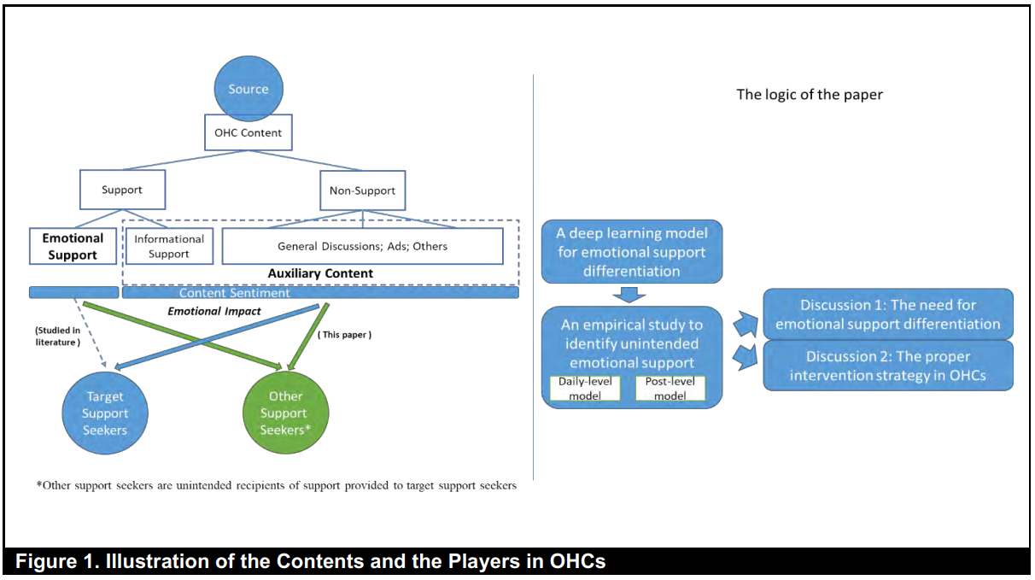
Introduction

Slide 4
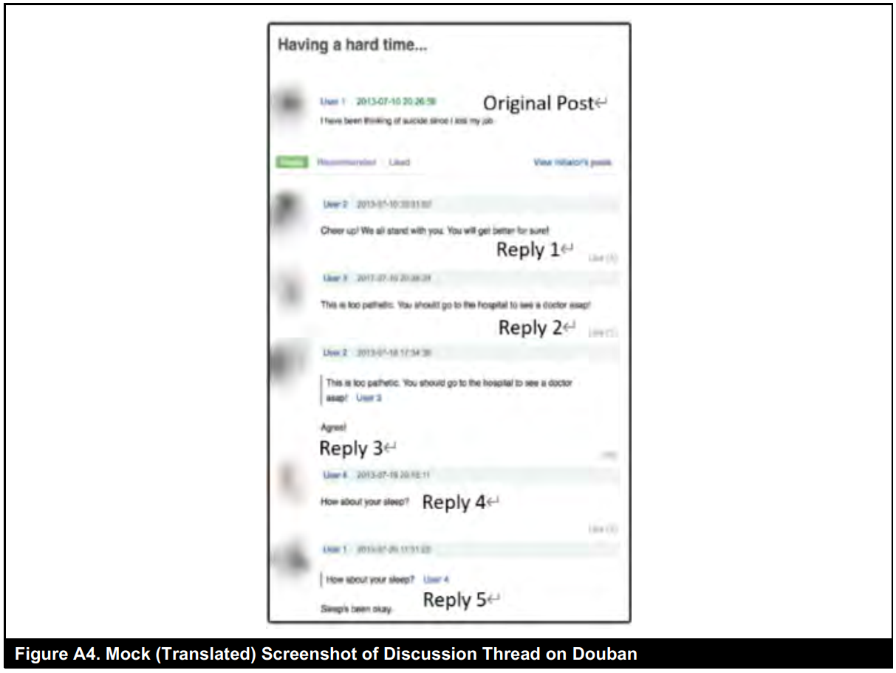
Introduction

Slide 5
Theoretical Basis
Two Theories Related to Emotional Support:
Appraisal theory
Emotional contagion theory
Appraisal Theory:
Emotional registration depends on the personal interpretation of the received stimulus
The same post may derive different emotional consequences in targeted and unintended recipients and generate outcomes that are not expected by support providers
Emotional Contagion Theory:
Users’ emotional states can be influenced by stimuli in posts, which can take the form of an emotional expression of both emotional support and auxiliary content
Two types of content may trigger different levels of social comparison and emotional effects due to their different purposes

Slide 6
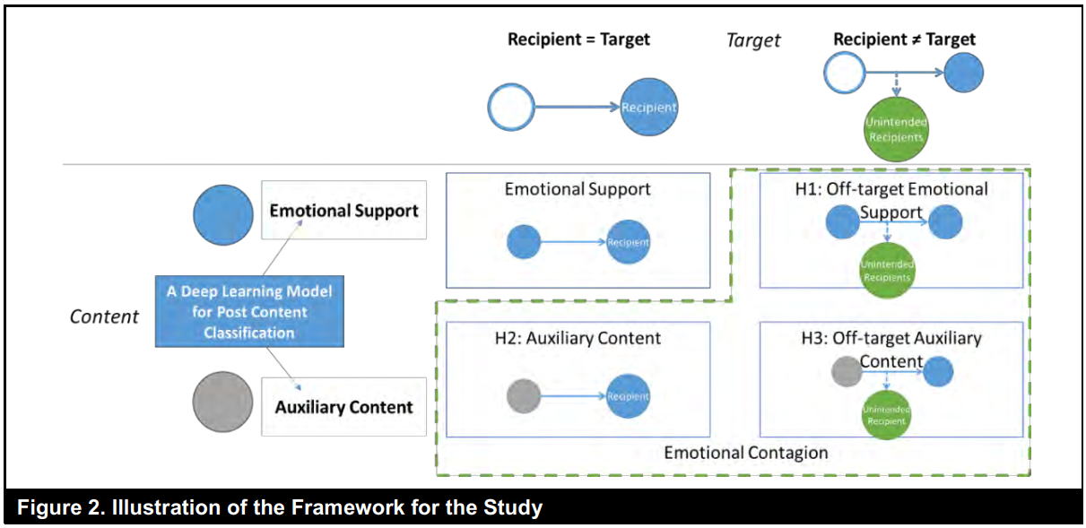
Theoretical Basis

Slide 7
Theoretical Basis
Appraisal Theory:
The same stimulus may derive different emotional sequences in on-target and off-target recipients
Empathy: When observing one person providing a positive expression to help another person, a support seeker may trigger empathy
Social Comparison (Envy): recipient may assume a competitive or comparative position
the more positive emotional support provided to targeted support seekers, the worse the emotions of unintended recipients will be
depression patients tend to rank themselves lower in terms of social comparison, making it easier for them to feel worse off when observing others receiving help and causing them to sense a negative effect
H1: The sentiment of the emotional support content targeting other support seekers will negatively influence the emotion of the support seeker (reflected by expression sentiment)

Slide 8
Theoretical Basis
Effect of Auxiliary Content:
including informational support, off-track discussions, and noise
may also impact support seekers in that they also contain emotional expressions
informational support in OHCs may direct readers to positive speculations for certain treatments
H2: The sentiment of the auxiliary content will positively influence the emotion of the targeted support seeker (reflected by expression sentiment)
When unintended persons read auxiliary content, it may also lead to two competing mechanisms
Auxiliary content tends to be more objective and contains less sense of a target
recipients would be less likely to form a social comparison with more objective information
Lower-level social comparison effect: the negative effect of off-target auxiliary content may not be stronger than the positive effect caused by empathy (may cancel out)
H3: The sentiment of the auxiliary content targeting other support seekers will NOT influence the emotion of a support seeker (reflected by expression sentiment)

Slide 9
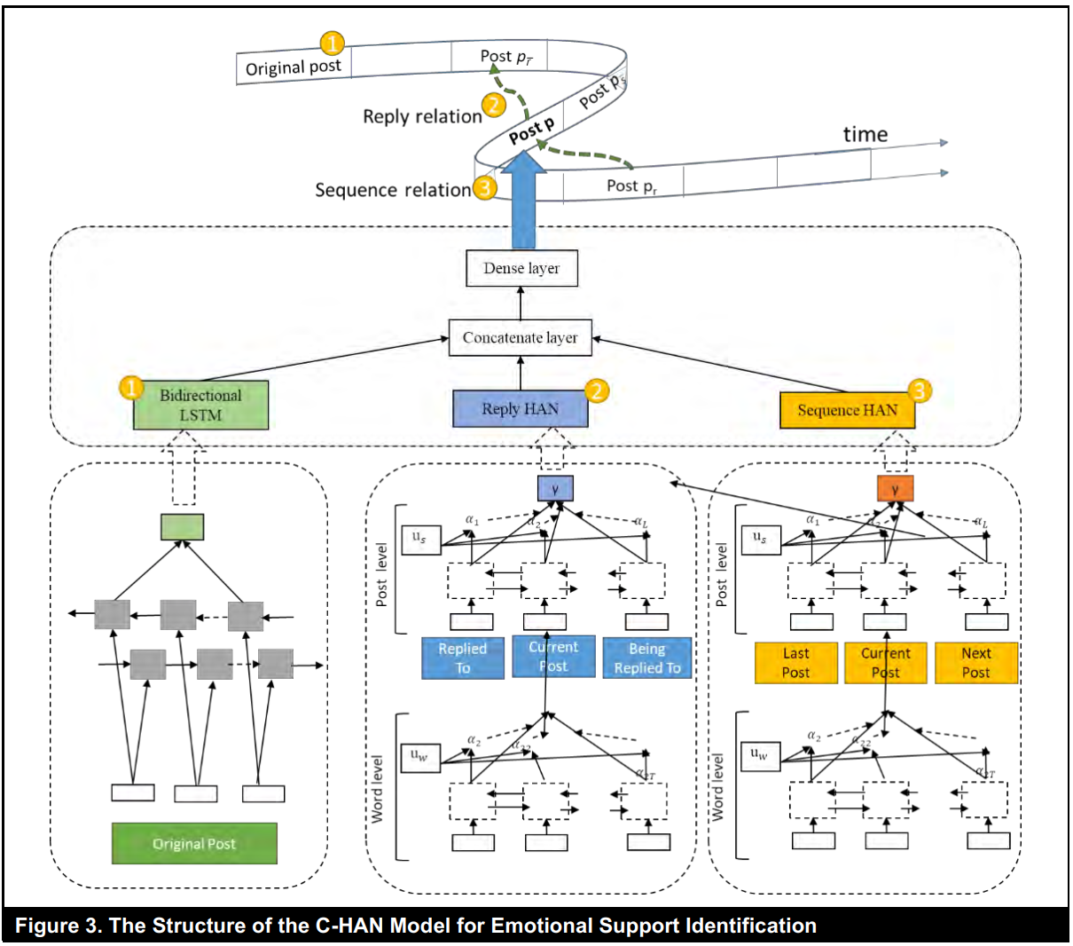
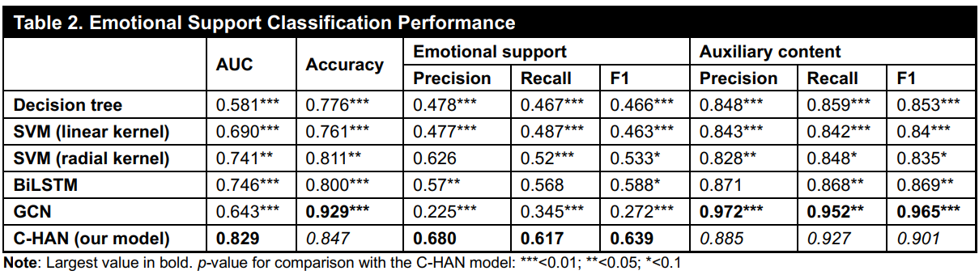
Methodology
Data Source
Douban (interest groups)
Emotional Support Differentiation
Differentiate between posts’ target and content type (emotional support or auxiliary content)
Build a compound hierarchical attention networks model (C-HAN)

Slide 10


Methodology
Empirical Setting
SENTIMENT: the sentiment of posts to reflect support seekers’ emotions
averaged the sentiment of all the support seeker’s posts each day as the dependent variable
Xi,t-1: independent variables (i.e., the four types of content in OHCs)
Select the last reply as the end of a user’s participation in a thread
sentiments of off-target emotional support (OT-EmoSupport)
sentiments of off-target auxiliary content (OT-AuxContent)
sentiment of emotional support (EmoSupport)
sentiments of auxiliary content (AuxContent)
Zi,t-1: control variables
Daily-level panel data model
Notes:
怎么判断某一个帖子是off-target还是targeted：核心就是看 “这条帖到底回复给谁”——如果回复对象是 S（显式或默认），就是针对 S 的 (on-target)；否则就是 off-target。
天级面板模型
因变量：对每个支持寻求者i在第t天所有发的帖子（可能跨多个线程），先分别算出每条帖子的情感值，然后取平均，得到当天的 SENTIMENTi,t\text{SENTIMENT}_{i,t}SENTIMENTi,t​ ​。
自变量：类似地，对第t−1 天该用户“参与”（即回复过）的所有线程中、他最后一次回复之前出现的所有 on-target/off-target 情感支持或辅助内容帖，分别求它们的平均情感，作为 EmoSupporti,t−1,OT-EmoSupporti,t−1 \text{EmoSupport}_{i,t-1}, \text{OT-EmoSupport}_{i,t-1}EmoSupporti,t−1​,OT-EmoSupporti,t−1​ 等指标 ​。
帖级“回复间”模型
每次用户在同一个线程连续回j−1 和j之间，将这两次回复之间出现的帖子（只看最近 10 条或 20 条）视作他确实看过的内容，分别计算这些内容的平均情感，再回归到回复j的情感上，检验情绪传染

Slide 11
Methodology
Empirical Setting
SENTIMENT: the sentiment of posts to reflect support seekers’ emotions
averaged the sentiment of all the support seeker’s posts each day as the dependent variable
Xi,t-1: independent variables (i.e., the four types of content in OHCs)
Zi,t-1: control variables
Number of replies: user’s emotion may depend on the volume of support received
Informational support: replies often contain health-related information
Support-seeking content: posts also contain support-seeking content
Activeness: support seekers’ emotions may depend on their own activities
Duration of support seeking: emotions can evolve over time even if they do not receive any social support
Daily-level panel data model
Notes:
怎么判断某一个帖子是off-target还是targeted：核心就是看 “这条帖到底回复给谁”——如果回复对象是 S（显式或默认），就是针对 S 的 (on-target)；否则就是 off-target。
天级面板模型
因变量：对每个支持寻求者i在第t天所有发的帖子（可能跨多个线程），先分别算出每条帖子的情感值，然后取平均，得到当天的 SENTIMENTi,t\text{SENTIMENT}_{i,t}SENTIMENTi,t​ ​。
自变量：类似地，对第t−1 天该用户“参与”（即回复过）的所有线程中、他最后一次回复之前出现的所有 on-target/off-target 情感支持或辅助内容帖，分别求它们的平均情感，作为 EmoSupporti,t−1,OT-EmoSupporti,t−1 \text{EmoSupport}_{i,t-1}, \text{OT-EmoSupport}_{i,t-1}EmoSupporti,t−1​,OT-EmoSupporti,t−1​ 等指标 ​。
帖级“回复间”模型
每次用户在同一个线程连续回j−1 和j之间，将这两次回复之间出现的帖子（只看最近 10 条或 20 条）视作他确实看过的内容，分别计算这些内容的平均情感，再回归到回复j的情感上，检验情绪传染

Slide 12
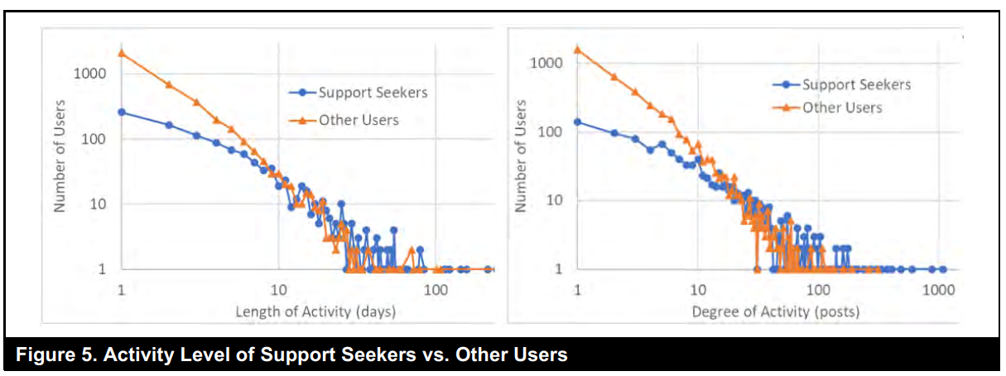
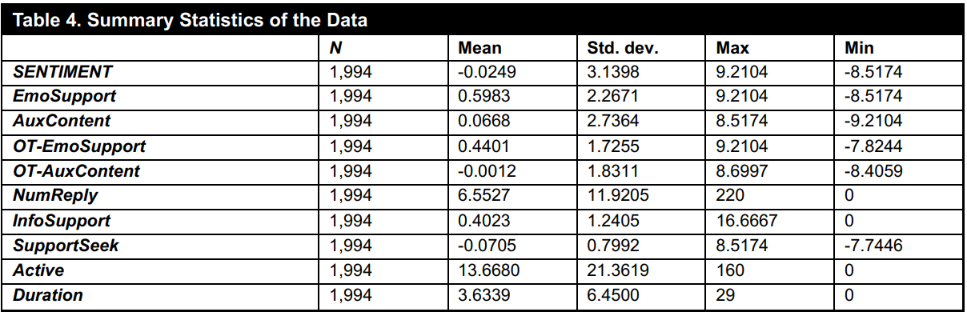
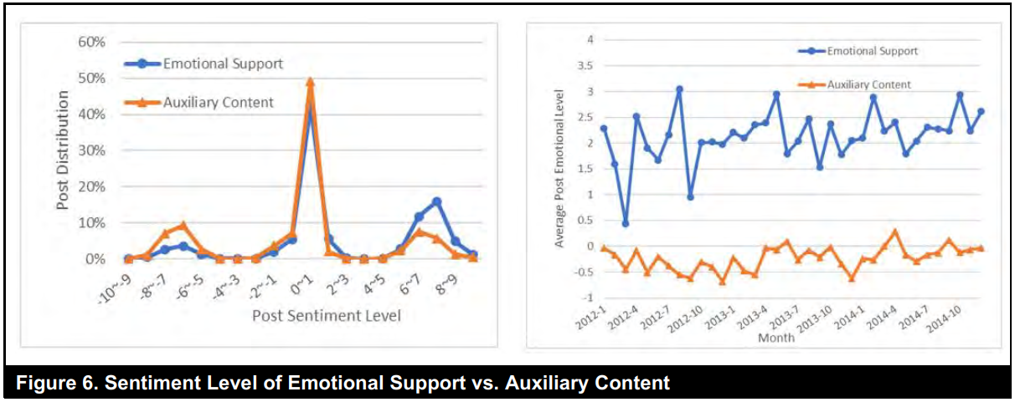
Result
Sample Size
3,323 threads (44,478 posts) by 4,692 users
1,994 user-day observations
Notes:
怎么判断某一个帖子是off-target还是targeted：核心就是看 “这条帖到底回复给谁”——如果回复对象是 S（显式或默认），就是针对 S 的 (on-target)；否则就是 off-target。
天级面板模型
因变量：对每个支持寻求者i在第t天所有发的帖子（可能跨多个线程），先分别算出每条帖子的情感值，然后取平均，得到当天的 SENTIMENTi,t\text{SENTIMENT}_{i,t}SENTIMENTi,t​ ​。
自变量：类似地，对第t−1 天该用户“参与”（即回复过）的所有线程中、他最后一次回复之前出现的所有 on-target/off-target 情感支持或辅助内容帖，分别求它们的平均情感，作为 EmoSupporti,t−1,OT-EmoSupporti,t−1 \text{EmoSupport}_{i,t-1}, \text{OT-EmoSupport}_{i,t-1}EmoSupporti,t−1​,OT-EmoSupporti,t−1​ 等指标 ​。
帖级“回复间”模型
每次用户在同一个线程连续回j−1 和j之间，将这两次回复之间出现的帖子（只看最近 10 条或 20 条）视作他确实看过的内容，分别计算这些内容的平均情感，再回归到回复j的情感上，检验情绪传染

Slide 13
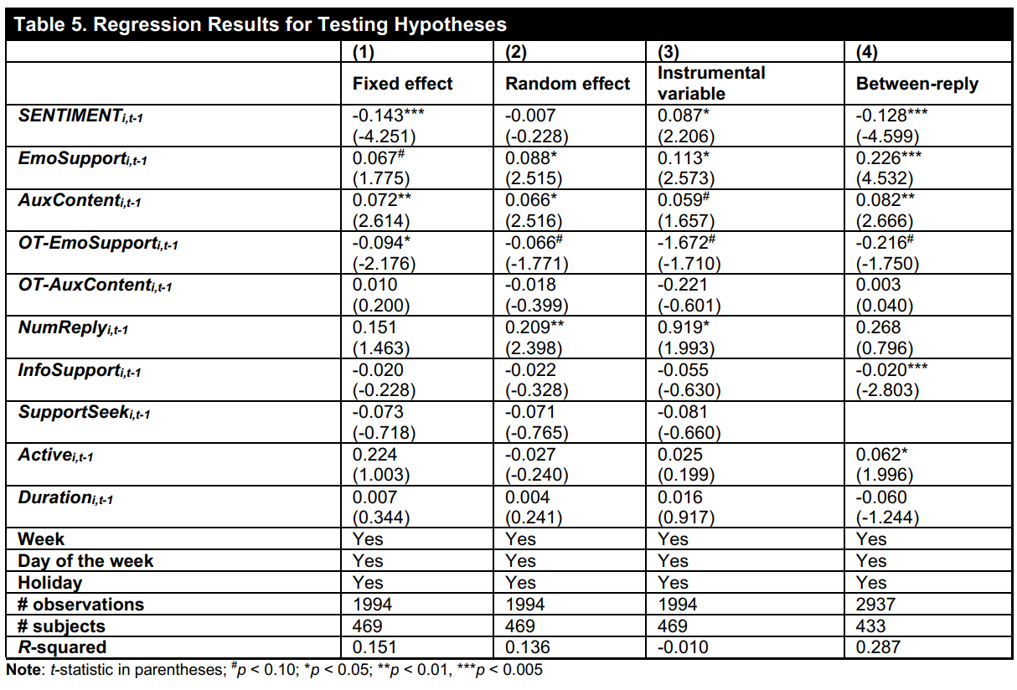
Result
H2
H1
H3
Notes:
怎么判断某一个帖子是off-target还是targeted：核心就是看 “这条帖到底回复给谁”——如果回复对象是 S（显式或默认），就是针对 S 的 (on-target)；否则就是 off-target。
天级面板模型
因变量：对每个支持寻求者i在第t天所有发的帖子（可能跨多个线程），先分别算出每条帖子的情感值，然后取平均，得到当天的 SENTIMENTi,t\text{SENTIMENT}_{i,t}SENTIMENTi,t​ ​。
自变量：类似地，对第t−1 天该用户“参与”（即回复过）的所有线程中、他最后一次回复之前出现的所有 on-target/off-target 情感支持或辅助内容帖，分别求它们的平均情感，作为 EmoSupporti,t−1,OT-EmoSupporti,t−1 \text{EmoSupport}_{i,t-1}, \text{OT-EmoSupport}_{i,t-1}EmoSupporti,t−1​,OT-EmoSupporti,t−1​ 等指标 ​。
帖级“回复间”模型
每次用户在同一个线程连续回j−1 和j之间，将这两次回复之间出现的帖子（只看最近 10 条或 20 条）视作他确实看过的内容，分别计算这些内容的平均情感，再回归到回复j的情感上，检验情绪传染

Slide 14
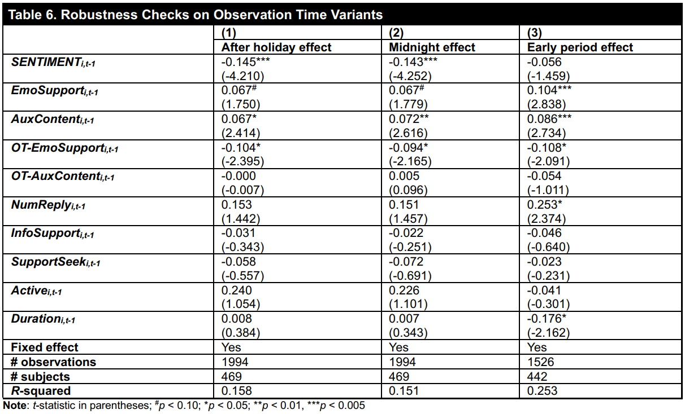
Result
Notes:
怎么判断某一个帖子是off-target还是targeted：核心就是看 “这条帖到底回复给谁”——如果回复对象是 S（显式或默认），就是针对 S 的 (on-target)；否则就是 off-target。
天级面板模型
因变量：对每个支持寻求者i在第t天所有发的帖子（可能跨多个线程），先分别算出每条帖子的情感值，然后取平均，得到当天的 SENTIMENTi,t\text{SENTIMENT}_{i,t}SENTIMENTi,t​ ​。
自变量：类似地，对第t−1 天该用户“参与”（即回复过）的所有线程中、他最后一次回复之前出现的所有 on-target/off-target 情感支持或辅助内容帖，分别求它们的平均情感，作为 EmoSupporti,t−1,OT-EmoSupporti,t−1 \text{EmoSupport}_{i,t-1}, \text{OT-EmoSupport}_{i,t-1}EmoSupporti,t−1​,OT-EmoSupporti,t−1​ 等指标 ​。
帖级“回复间”模型
每次用户在同一个线程连续回j−1 和j之间，将这两次回复之间出现的帖子（只看最近 10 条或 20 条）视作他确实看过的内容，分别计算这些内容的平均情感，再回归到回复j的情感上，检验情绪传染

Slide 15

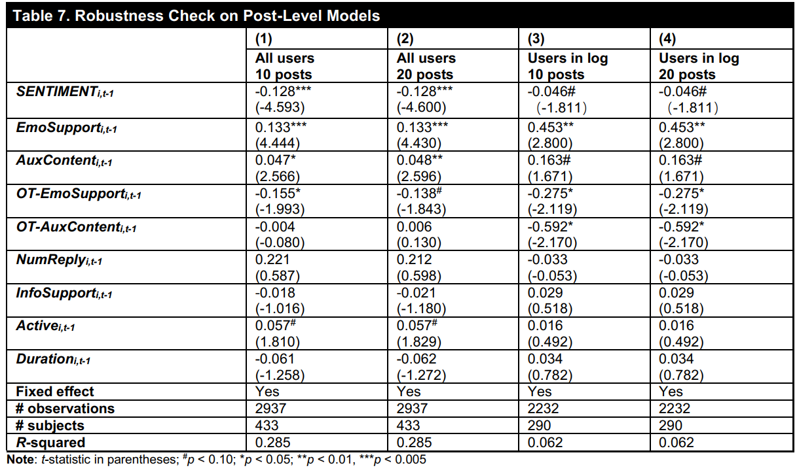
Result
Notes:
怎么判断某一个帖子是off-target还是targeted：核心就是看 “这条帖到底回复给谁”——如果回复对象是 S（显式或默认），就是针对 S 的 (on-target)；否则就是 off-target。
天级面板模型
因变量：对每个支持寻求者i在第t天所有发的帖子（可能跨多个线程），先分别算出每条帖子的情感值，然后取平均，得到当天的 SENTIMENTi,t\text{SENTIMENT}_{i,t}SENTIMENTi,t​ ​。
自变量：类似地，对第t−1 天该用户“参与”（即回复过）的所有线程中、他最后一次回复之前出现的所有 on-target/off-target 情感支持或辅助内容帖，分别求它们的平均情感，作为 EmoSupporti,t−1,OT-EmoSupporti,t−1 \text{EmoSupport}_{i,t-1}, \text{OT-EmoSupport}_{i,t-1}EmoSupporti,t−1​,OT-EmoSupporti,t−1​ 等指标 ​。
帖级“回复间”模型
每次用户在同一个线程连续回j−1 和j之间，将这两次回复之间出现的帖子（只看最近 10 条或 20 条）视作他确实看过的内容，分别计算这些内容的平均情感，再回归到回复j的情感上，检验情绪传染

Slide 16
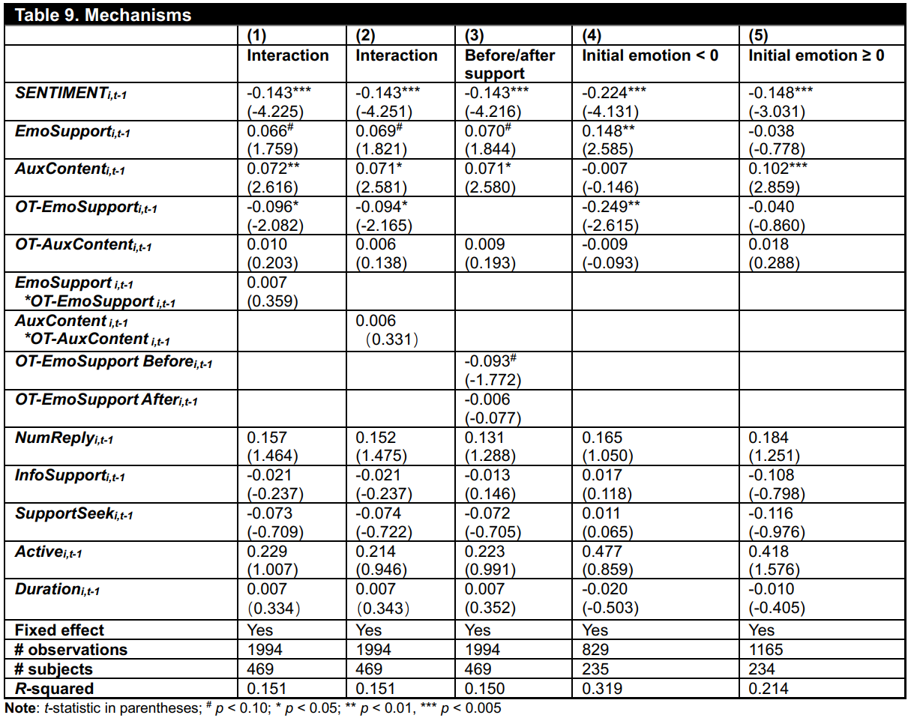
Result
Notes:
“先／后收到情感支持”对比检验
将每日的 off-target 情感支持，按用户是否在同一天“先”或“后”收到任何 on-target 情感支持分为两类：
OT-EmoSupport Beforeₜ₋₁（当日未先收到情感支持）
OT-EmoSupport Afterₜ₋₁（当日已先收到情感支持）
回归结果表明，只有在用户当日未先获得任何情感支持时，off-target 情感支持才对其情绪有显著的负向影响；如果已经先收到情感支持，则该负向效应不显著。这一差异强化了“社交比较”机制：看到他人被支持而自己未被支持，更易产生负面感觉 ​
基于初次发帖情感的异质性检验
按用户最初的求助帖情感（即反映其抑郁程度）分组：
“首次情感 < 0”（情感更负面，抑郁程度更高）
“首次情感 ≥ 0”（情感中性或正面）
在情感更负面组中，off-target 情感支持的负向影响显著且较大；在情感较好的组中，则不显著。这表明抑郁程度更严重的用户，更容易因社交比较而受到 off-target 支持的负面冲击 ​

